Slide 1



Slide 2
Framework?
A web framework is a software platform that provides a structured and standardized way to build web applications.

Slide 3
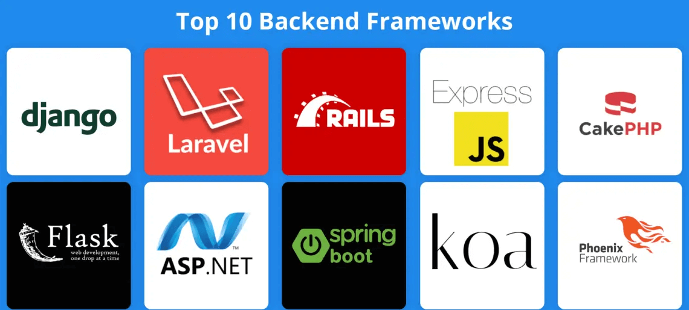
Popular Web Frameworks

Slide 4
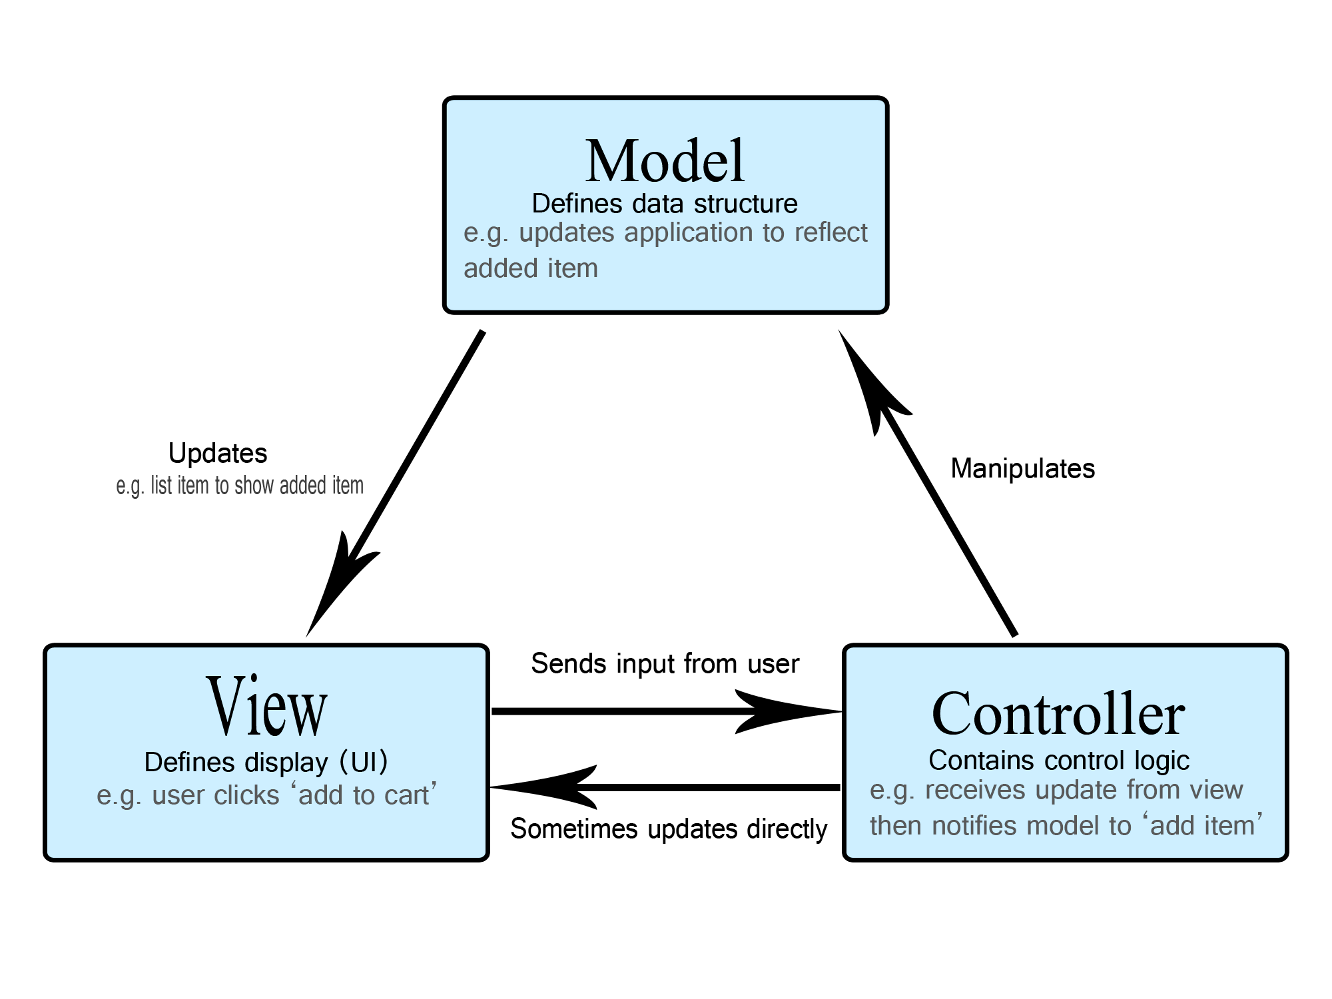
What is MVC ?

Slide 5
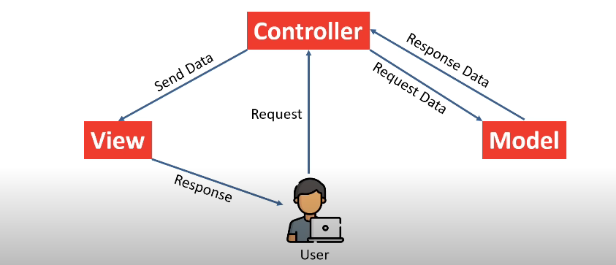

Slide 6
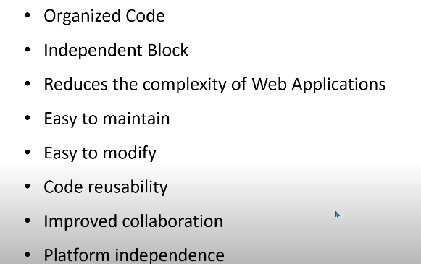
Benefits of MVC

Slide 7
Laravel
Laravel is a PHP-based web framework for building high-end web applications using its significant and graceful syntaxes.
Taylor Otwell developed Laravel in July 2011, and it was released more than five years after the release of the Codeigniter framework.

Slide 8
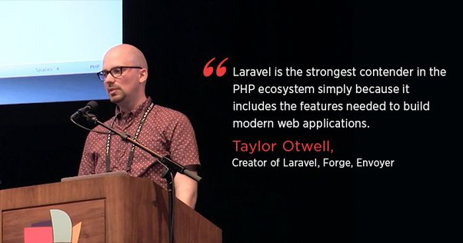

Slide 9
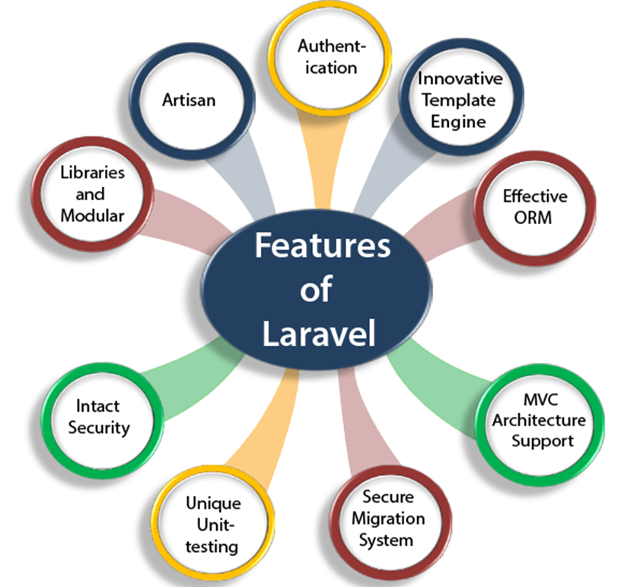

Slide 10
Authentication
Authentication is the most important factor in a web application, and developers need to spend a lot of time writing the authentication code. Laravel contains an inbuilt authentication system, you only need to configure models, views, and controllers to make the application work.

Slide 11
Innovative Template Engine
Laravel's innovative template engine, called Blade, is designed to simplify the process of creating and managing views (templates) in web applications. Blade provides a clean, expressive syntax that allows developers to write views with ease while providing powerful features for dynamic content rendering.

Slide 12
Effective Object Relational Mapping
When building applications, developers often use object-oriented programming languages like Python, Java, or php to represent entities and their relationships. These entities are typically classes that have attributes and methods. However, databases primarily store data in tables with rows and columns.

Slide 13
ORMs provide a solution to this problem by abstracting the database interactions and mapping the objects to database tables, thereby enabling developers to work with their preferred object-oriented paradigm without worrying about the underlying database structure.

Slide 14
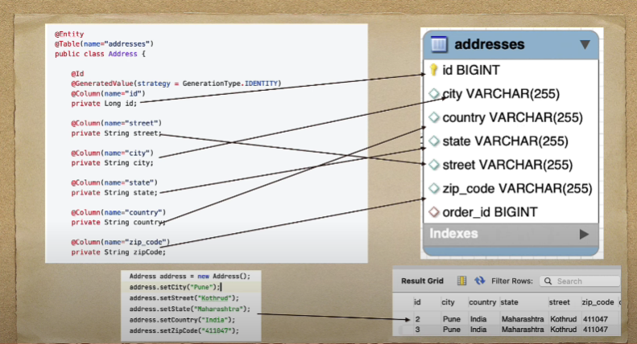

Slide 15
Laravel's support for the Model-View-Controller (MVC) architectural pattern brings several benefits to web application development. MVC is a software design pattern that separates the application logic into three interconnected components: Model, View, and Controller.

Slide 16
Secure Migration System
Laravel's migration system simplifies the process of managing database changes in a structured and consistent manner. It promotes version control of the database schema and helps developers work collaboratively, ensuring the security and integrity of the application's database.

Slide 17
Unique Unit Testing
Laravel seamlessly integrates with PHPUnit, one of the most widely used and well-established testing frameworks in the PHP ecosystem. PHPUnit offers a rich set of assertion methods and testing features, making it easier to write clear and concise tests.
Laravel Dusk, the built-in browser testing tool, provides an excellent way to perform end-to-end tests and interact with your application as a real user would.

Slide 18
Intact Security
Laravel uses bcrypt hashing to securely store user passwords. Bcrypt is a strong and slow hashing algorithm, making it difficult for attackers to crack passwords using brute-force attacks.

Slide 19
Libraries and Modules
Laravel is very popular, as some object-oriented libraries and pre-installed libraries are added in this framework; these pre-installed libraries are not added in other PHP frameworks. One of the most popular libraries is an authentication library that contains some useful features such as password reset, monitoring active users, bcrypt hashing, and CSRF protection. This framework is divided into several modules that follow the PHP principles, allowing the developers to build responsive and modular apps.

Slide 20
Artisan
The Laravel framework provides a built-in tool for the command line known as Artisan that performs the repetitive programming tasks that do not allow the PHP developers to perform manually. These artisans can also be used to create the skeleton code, database structure, and its migration, so it makes it easy to manage the database of the system. It also generates the MVC files through the command line. Artisan also allows the developers to create their own commands.

Slide 21
Requirements for Laravel project
Xampp (supporting php> 8.2)
Composer
VS-Code

Slide 22
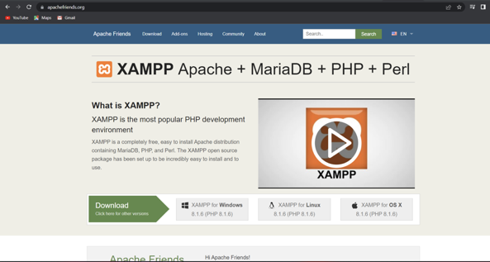
GO to apachefriends.org

Slide 23
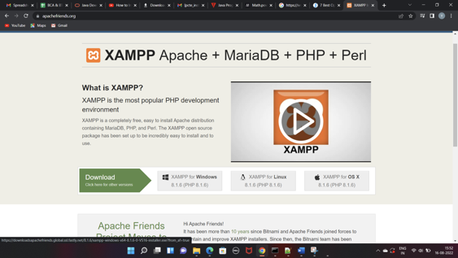
Go To XAMPP for Windows

Slide 24
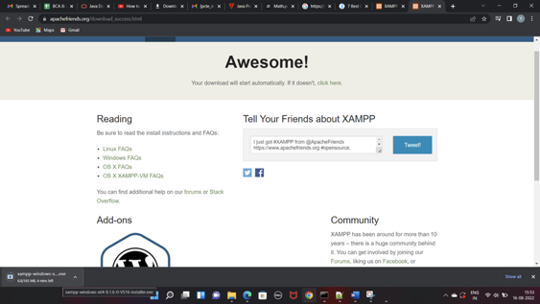
XAMPP will start downloading

Slide 25

Composer
For managing the project's dependencies.
Its main purpose is to simplify the process of including external libraries and packages into your Laravel application.

Slide 26
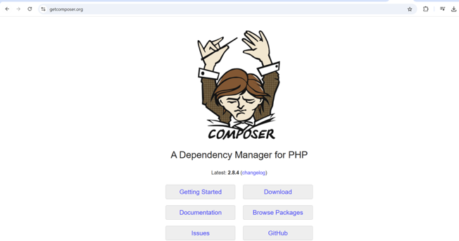
Go to getcomposer.org

Slide 27
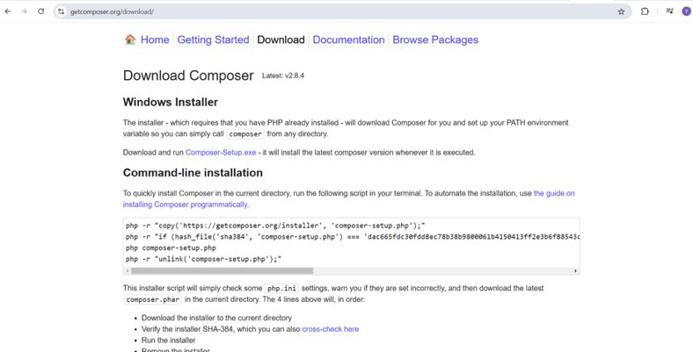
After clicking on Downloads run Composer-setup.exe file

Slide 28
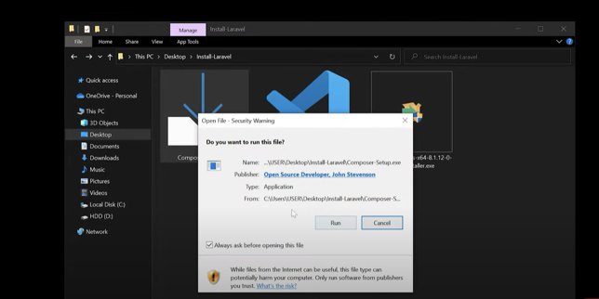
Click on Run

Slide 29
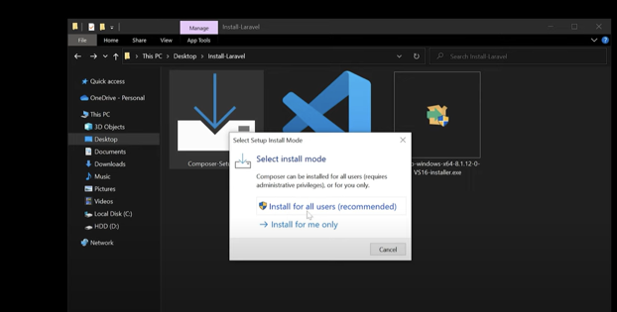
Click on Install for all users

Slide 30
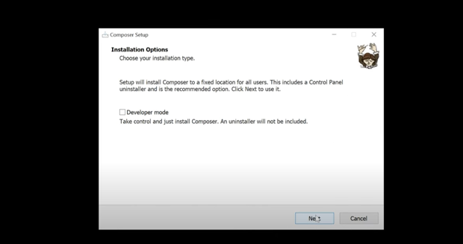
Click on Next

Slide 31
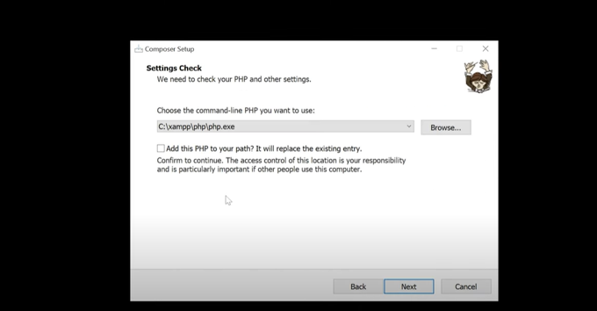
Click on Check Box and click on Next

Slide 32
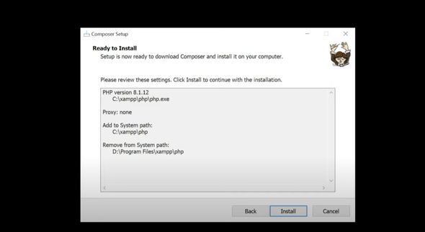
Click on Install

Slide 33
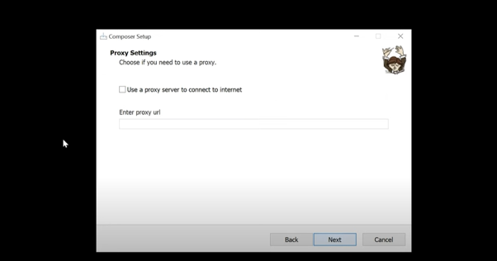
Click on Next

Slide 34
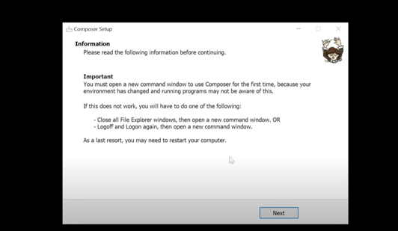
Click Next

Slide 35
Check PHP Version
php -v
Check Git Version
git --version
Check Composer Version
composer --version
Or
composer
Check Laravel version
laravel -v

Slide 36
Installation of Laravel
Global Installation
1- composer global require laravel/installer (one-time command)
2- laravel new first-app (for new app)
Per-project Installation
composer create-project laravel/laravel first-app (every time for new app)

Slide 37
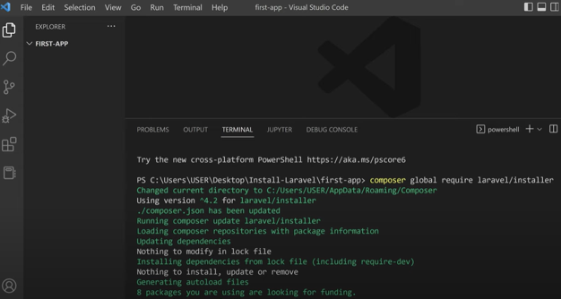
Open the folder in VS Code and run the command
(Terminal New Terminal)

Slide 38
Issues and solutions- When running the composer global require laravel/installer
Git installation,
modifying the php.ini file,
or environment configuration.

Slide 39
Problem:
Composer requires Git to download dependencies (like laravel/installer) from repositories. If Git is not installed or not properly set up, you'll see errors like:bashCopy code
Failed to clone ... repository not found
Need XAMPP Latest Version
composer clear –cache on terminal
Then install composer

Slide 40
Solution:
Verify Git Installation:
Run git --version in the terminal to check if Git is installed.
Install Git:On Windows: Download Git from git-scm.com and follow the installation instructions.
Modifying php.ini File:
The php.ini file often needs to be updated, which involves removing the semicolon (;) in front of specific lines to enable extensions.
extension=zip
Remove ; from above line

Slide 41
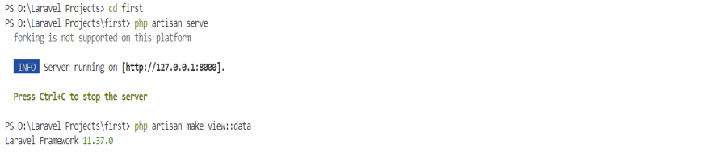
Running a Laravel app
cd first-app
php artisan serve

Slide 42
The artisan serve command in Laravel is a way to start a built-in PHP development server for your Laravel project.
This command is commonly used during local development to quickly serve your application without needing to set up a full web server like Apache.
Starts a local development server at http://127.0.0.1:8000 by default.
It allows developers to test their Laravel application locally in a browser.
Default Port Number: 8000

Slide 43
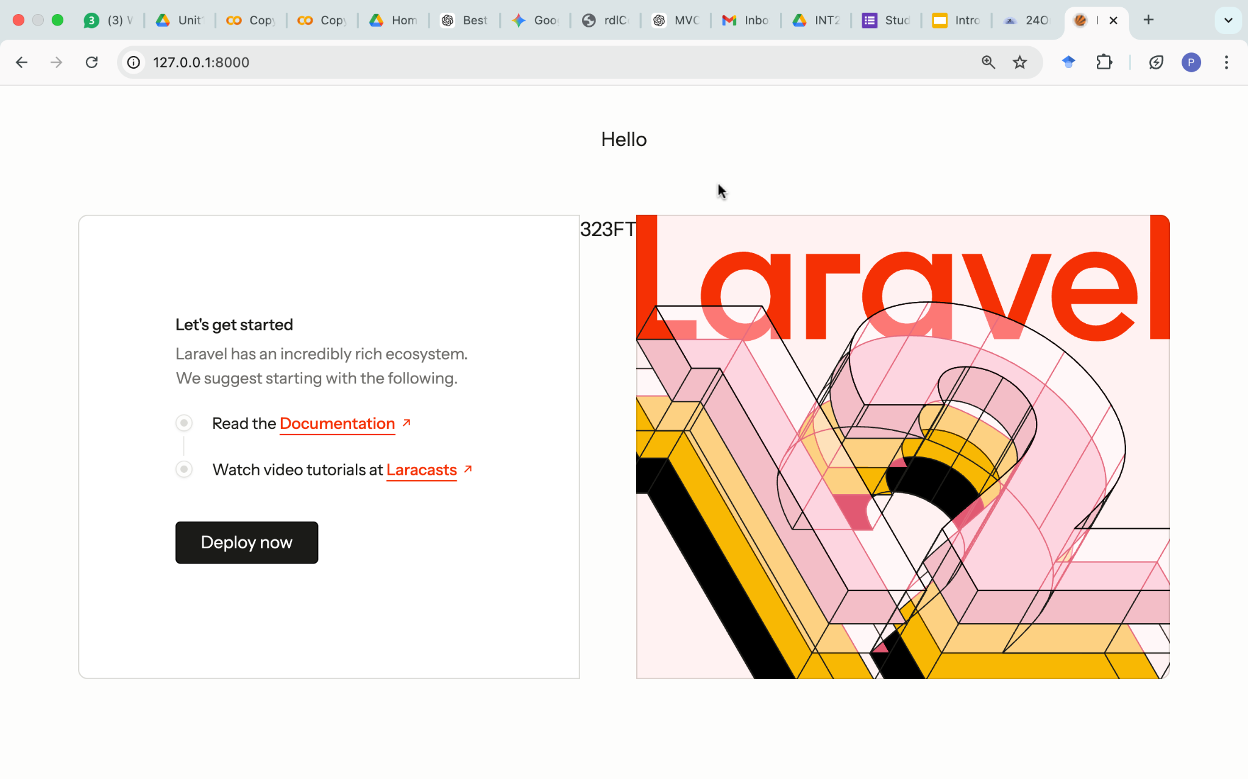
Laravel Home Page

Slide 44
Artisan
Command line interface used in Laravel is called Artisan.
It includes a set of commands which assists in building a web application.
Artisan is Laravel’s command-line interface (CLI) that provides powerful commands for automating tasks like database migrations, model generation, route listing, and caching.
It helps developers save time by reducing manual work.
php artisan list
Displaying All Artisan Commands

Slide 45
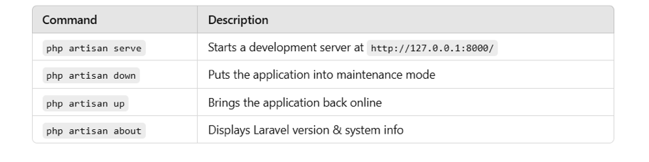
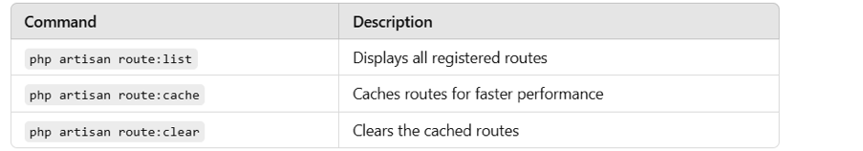
A. Application Management
B. Route Management

Slide 46
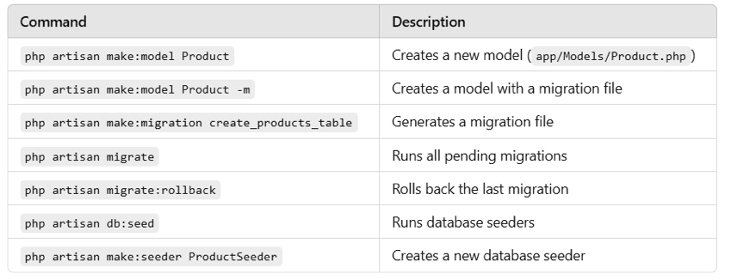
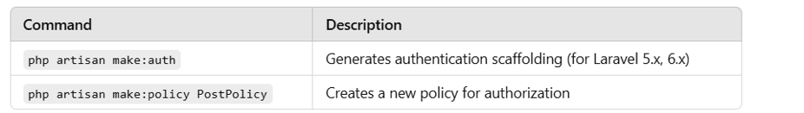
C. Model & Database Commands
D. Authentication & Authorization

Slide 47
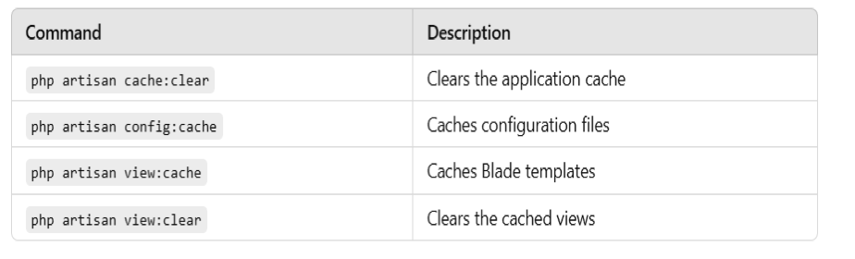
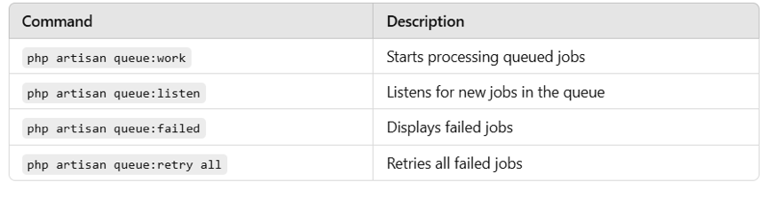
E. Caching & Performance Optimization
F. Queues & Jobs

Slide 48
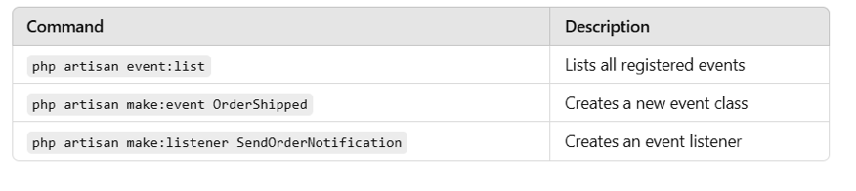
G. Event & Listener Commands

Slide 49
What does MVC stand for in software development?
a) Model-View-Controller
b) Most Valuable Code
c) Managed View Components
d) Modular-Visual-Creation
Always Remember……
MVC is indeed a broader design pattern that defines the high-level architecture of an application, emphasizing the separation of concerns. However, when implementing the MVC pattern, the actual code is organized into separate layers to achieve modularity, maintainability, and scalability.

Slide 50
What is the primary purpose of the Model in the MVC architecture?
a) Handles user interactions and presentation logic
b) Represents the data and business logic of the application
c) Renders the user interface and displays data
d) Manages the communication between the Model and View
What is Laravel?
a) A programming language
b) A JavaScript library
c) A PHP web application framework
d) A database management system

Slide 51
Do you know?
Originally, PHP stood for "Personal Home Page," as it was created to manage Rasmus Lerdorf's personal website in 1994.

Slide 52
Which command is used to create a new Laravel project using Composer?
a) composer create-project Laravel app-name
b) composer new laravel/laravel
c) laravel new app-name
d) composer new-project laravel/laravel
What is Eloquent in Laravel?
a) A templating engine
b) A database management system
c) A PHP extension for performance optimization
d) An ORM (Object-Relational Mapping) for database interactions

Slide 53


Slide 54
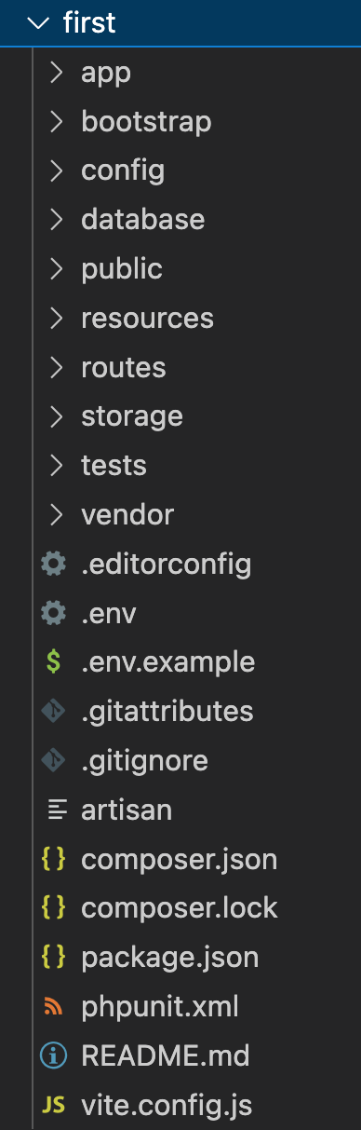
Directory Structure
The default Laravel application structure is intended to provide a great starting point for both large and small applications. But you are free to organize your application however you like.

Slide 55
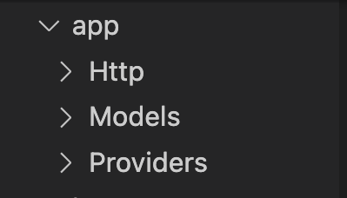
App -> Http
This directory houses the controllers, middleware, and form requests. Controllers handle HTTP requests and responses, middleware provides a way to filter incoming HTTP requests, and form requests handle form validation logic.

Slide 56
App -> Models
In this directory, you define the Eloquent ORM models. Eloquent is Laravel's built-in ORM that allows you to interact with the database using an expressive syntax.
Providers
Stores service provider classes.
Service providers are responsible for bootstrapping your application.
By default, Laravel includes several providers, such as AppServiceProvider, AuthServiceProvider, and EventServiceProvider.

Slide 57
Do you know ?
Laravel drew inspiration from several other frameworks, including Ruby on Rails, ASP.NET MVC, and Sinatra. It combines the best features from these frameworks and adds its own unique elements.

Slide 58
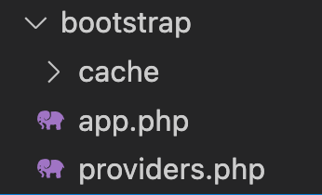
The Bootstrap Directory
The bootstrap directory contains files responsible for
bootstrapping the Laravel application.
app.php: This file loads the basic application configuration and creates an instance of the Laravel application.
cache: The cache directory contains compiled service container and configuration files. These files improve the application's performance by reducing the bootstrapping time.

Slide 59
In a standard Laravel project, which directory contains the main application logic and business-specific code?
a) resources
b) public
c) app
d) database

Slide 60
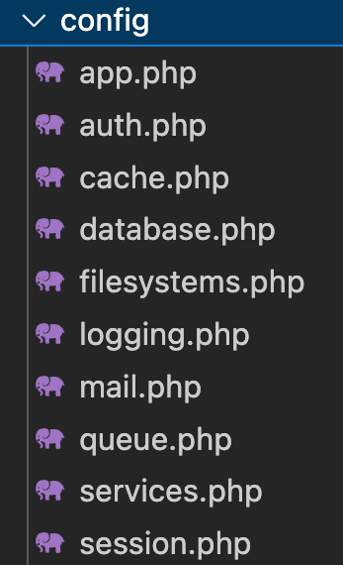
Config Directory
The config directory houses various configuration files for different components of the Laravel application. You can customize settings like database connections, application settings, cache configurations, and more from these files.

Slide 61
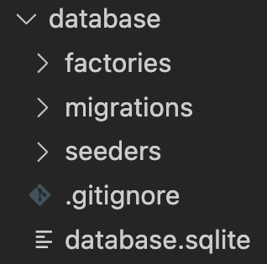
Database Directory
The database directory contains database-related files, including migrations, seeds, and factories.

Slide 62
Database -> Factories
Factory classes are used to define data blueprints that can be used to create dummy data for testing.
Database -> Migration
Migrations are version control for your database. They allow you to modify the database schema and keep it in sync with your application code.
Database -> Seeds
Seed classes allow you to populate your database with sample data for testing or initial setup.

Slide 63
In Laravel, where do you define the database schema and migrations for creating and modifying database tables?
a) resources/views
b) app
c) database/migrations
d) config

Slide 64
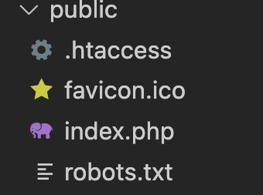
Public Directory
The public directory is the web server's document root. It contains the index.php file, which is the entry point for all HTTP requests.
configures autoloading
It is the directory where all public-facing files reside, such as assets, images, Javascipt, CSS and favicon icon and the primary PHP file that handles incoming requests.

Slide 65
Which directory is used for storing publicly accessible assets such as images, stylesheets, and JavaScript files?
a) resources
b) public
c) storage
d) app

Slide 66
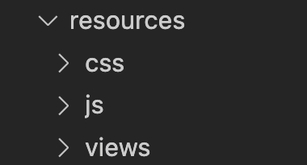
Resource Directory
The resources directory contains the views, language files, and assets (CSS, JavaScript, and images) for the application.
Views: The views directory stores Blade templates that define the UI of the application.
Lang: The lang directory holds language files for localization and internationalization purposes.
Assets: The assets directory contains raw CSS, JavaScript, and other assets. These assets are usually compiled and optimized using Laravel Mix.

Slide 67
Do you Know?
It takes less than a second (0.9 seconds to be precise) for users to form their opinions on their initial visit to a web page.

Slide 68
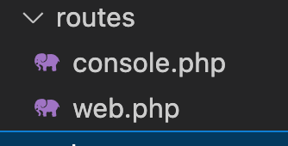
Routes Directory
The routes directory contains route definition files.
web.php: This file contains routes that are typically associated with web-based user interfaces.
api.php: This file contains routes for API endpoints, usually meant to return JSON responses.

Slide 69
routes/web.php (opened at which link)
In Laravel, the routes/web.php file is where you define routes for web interfaces of your application.
These routes typically respond to requests made via a web browser and are grouped within the web middleware group, which provides features such as session handling, CSRF protection, and cookie encryption.
Basic Route Example:
Route::get('/', function () {
return view('welcome');
});

Slide 70
routes/console.php file (Console commands)
The routes/console.php file in Laravel is where you define all custom Artisan commands for your application.
This file allows you to extend and customize the functionality of Laravel's command-line interface (CLI)/terminals.
Not used directly

Slide 71
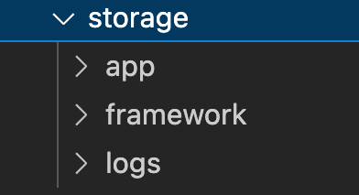
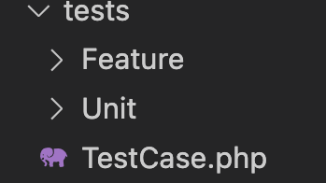
Storage Directory
The storage directory holds various files generated by the application, such as logs, cache, sessions, and uploaded files.
Test Directory
The tests directory contains test cases for the application.

Slide 72
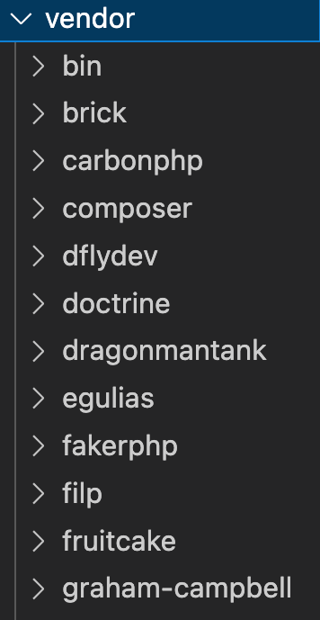
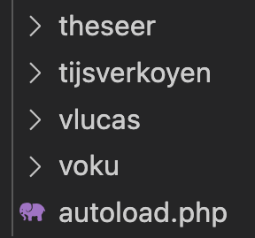
Vendor Directory
The vendor directory houses all the third-party dependencies installed via Composer, including Laravel itself.

Slide 73
Vendor folder (mentioned in composer.json and stored in Vendor)
The vendor folder in a Laravel project is where Composer stores all the third-party dependencies required for the application.
It is automatically generated and managed by Composer and includes libraries, frameworks, and tools specified in the composer.json file.

Slide 74
Autoloading:
The vendor/autoload.php file is the main entry point for Composer's autoloading mechanism.
Laravel's bootstrap/app.php includes this file to autoload all necessary classes
Organizational Structure:
Dependencies are organized in subdirectories based on their namespaces (e.g., vendor/symfony/, vendor/laravel/).
It also contains the composer/ directory, which manages autoloading and metadata about the dependencies.

Slide 75
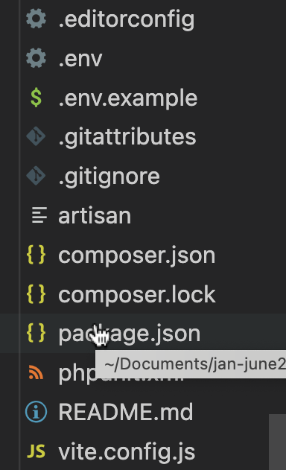
.editorconfig
This file is used to maintain consistent coding styles across different editors and IDEs in a project.
It allows you to change settings without modifying code
Stores database credentials
Keeps API keys secure
Helps manage different environments (local, production)

Slide 76
.env
The .env (environment file) is used to store configuration settings and sensitive data for your application.
It allows you to change settings without modifying code
Stores database credentials
Keeps API keys secure
Helps manage different environments (local, production)

Slide 77
.env.example
The .env.example file is a template of the .env file.
It contains all required configuration keys, but without real/sensitive values
Helps other developers know which environment variables are needed
Used when setting up a project for the first time
Keeps secrets safe (no passwords or API keys inside)
It looks almost like .env, but values are dummy/empty

Slide 78
.gitattributes
The .gitattributes file is used by Git to control how files are handled in a repository.
Line endings
File merging behavior
Exporting files
Language detection (GitHub)
Ensures consistent behavior across systems (Windows/Linux/Mac)
Prevents merge conflicts
Helps GitHub correctly detect languages
Controls what files are included in archives

Slide 79
composer.json
The `composer.json` file is the main configuration file for Composer (PHP dependency manager).
Which libraries/packages your project needs
How to autoload classes
Project metadata & scripts
composer.lock
The composer.lock file is generated by Composer and stores the exact versions of all installed dependencies in your project.
While composer.json defines what you want, composer.lock records what you actually got installed
Exact package versions
Dependency tree (sub-dependencies)
Download sources (URLs)
Hash for verification

Slide 80
package.json
package.json is a file that manages JavaScript dependencies and scripts in a project.
phpunit.xml
The phpunit.xml file is a configuration file for PHPUnit, which is used for testing in PHP/Laravel. It defines:
Test environment settings
Database config for testing
Test directories

Slide 81
README.md
The README.md file is a documentation file that explains your project. It is written in Markdown (.md) format and is the first file people see on GitHub.
vite.config.js
The vite.config.js file is a configuration file for Vite, a modern frontend build tool used in Laravel.
It controls how your CSS, JavaScript, and assets are compiled and served

Slide 82
In every Laravel project, you will have two files, composer.json and composer.lock. What is the difference between them?

Slide 83
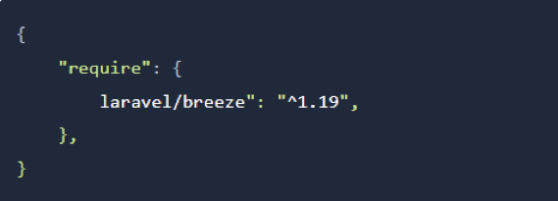
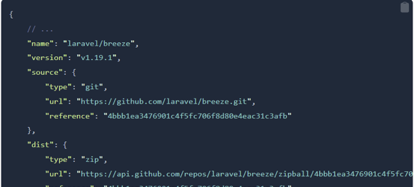
In composer.json you specify what packages should be installed, and with what versions.
Now, which exact version is installed at any moment? Here comes the composer.lock file.

Slide 84
Which directory contains the views (templates) used for rendering HTML pages in Laravel?
a) resources
b) public
c) app
d) routes
Which directory is used for storing files generated by the application, such as logs, cache, and session data?
a) resources
b) public
c) storage
d) config

